Slide 1

TASK-1
Name : Appini Akhil E-mail: appiniakhil01@gmail.com Contact no.: 7569891286

Slide 2

PortSwigger lab’s
snapshots in next few slides showing the completion of
task 1

Slide 3
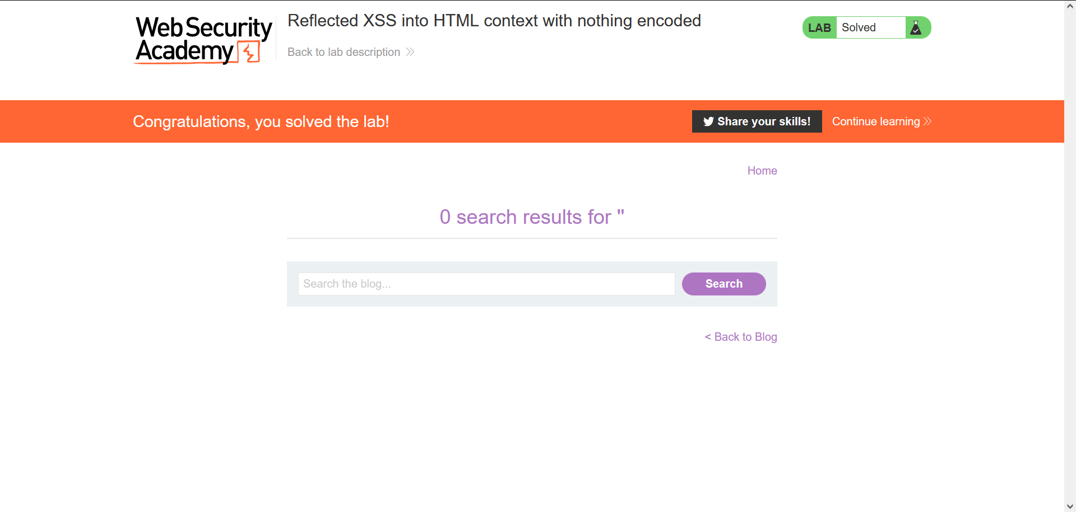

Slide 4


Slide 5


Slide 6


Slide 7


Slide 8
Thank You

